Slide 1
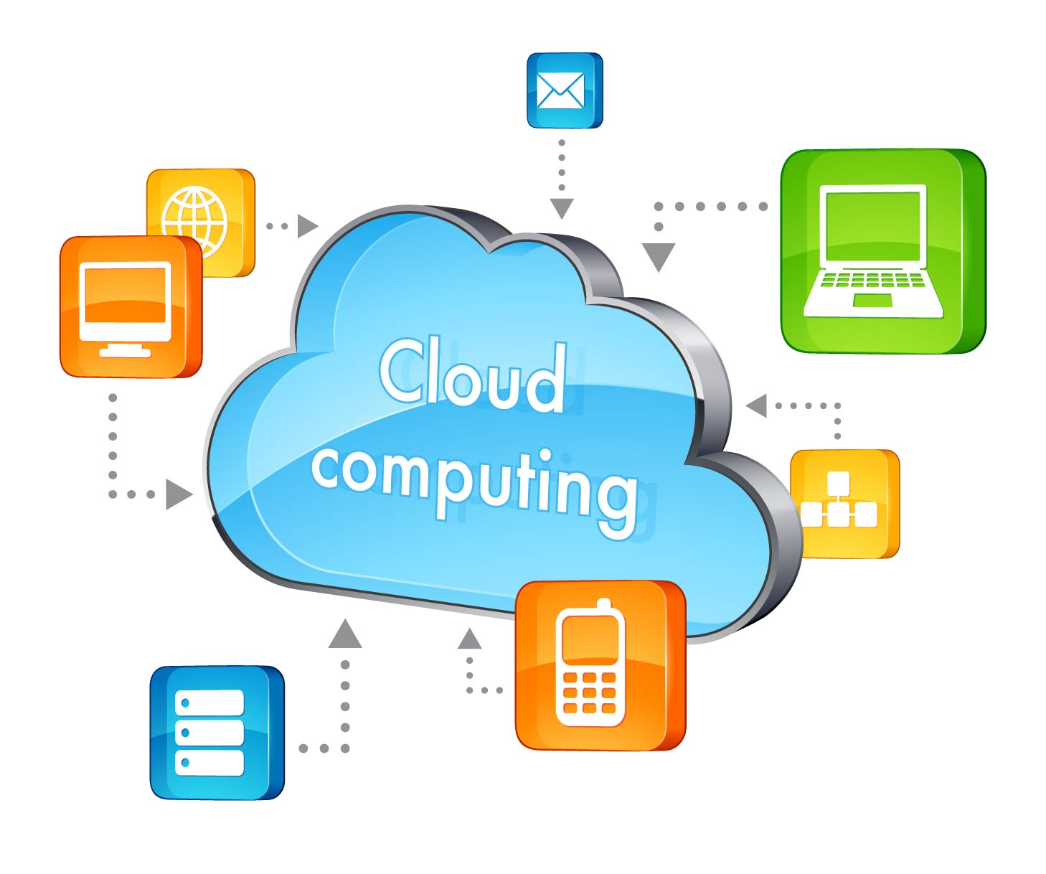
CLOUD COMPUTING
Submitted By
AKASHDEEP AWASTHI
1900970140006

Slide 2
INTRODUCTION
CLOUD:
The term cloud refers to a network or the net. it's a technology that uses remote servers on the net to store, manage, and access information on-line instead of native drives. the info is something like files, images, documents, audio, video, and more.
Cloud Computing can be further explained like to handling, configuring, and accessing the hardware and package resources remotely. It offers on-line data storage, infrastructure, and application. Cloud computing offers platform freedom, because the package isn't needed to be put in regionally on the laptop. Hence, the Cloud Computing is creating our business applications mobile and cooperative. Cloud computing metaphor: the cluster of networked parts providing services needn't be one by one addressed or managed by users; instead, the whole provider-managed suite of hardware associate degreed package is thought of as an amorphous cloud. Clouds could also be restricted to one organization, or be out there to multiple organizations (public cloud).

Slide 3
TECHNOLOGY
VIRTUALIZATION
The main facultative technology for Cloud Computing is Virtualization. Virtualization could also be a partitioning of single physical server into multiple logical servers. Once the physical server is split, every logical server behaves sort of a physical server and may run associate degree software and applications severally. several fashionable companies’s like VmWare and Microsoft offer virtualization services, wherever rather than victimization your personal computer for storage and computation, you utilize their virtual server. they're quick, cost-efficient and fewer time intense.
SERVICE ORIENTED APPROACH (SOA)
Service-Oriented design helps to use applications as a service for different applications regardless the kind of trafficker, product or technology. Therefore, it's doable to exchange the info between applications of various vendors while not further programming or creating changes to services.

Slide 4
Grid Computing:
Grid computing uses the on the market resource and interconnected pc systems to accomplish a typical goal. Grid
computing may be a surbanised model, wherever the computation might occur over several body model. A grid may be a assortment of computers that is owned by a multiple parties in multiple locations and connected along in order that users will share the combined power of resources. Grid provides restricted services. Grid computing federates the resources settled inside completely different organization.
Utility Computing:
Utility computing refers to the flexibility to charge the offered services, and charge customers for precise usage Utility computing users need to be up to speed of the geographical location of the infrastructure Utility computing is additional favorable once performance and choice infrastructure is essential Utility computing could be a sensible choice for fewer resource exacting Utility computing refers to a business model.

Slide 5
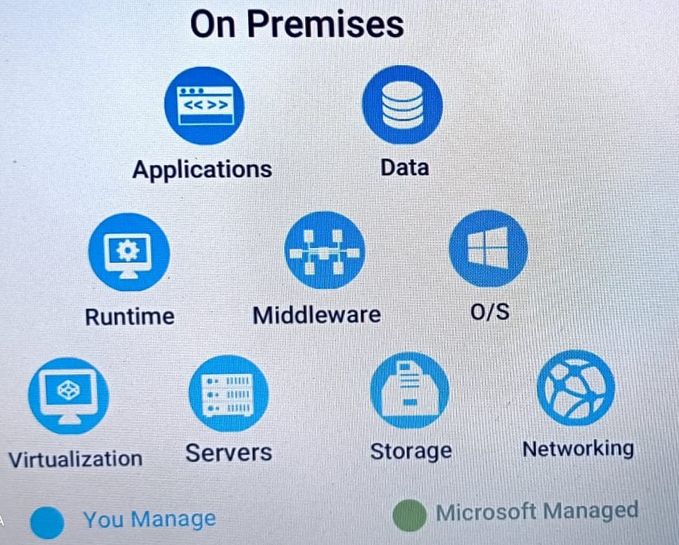
SCOPE OF CLOUD COMPUTING

Slide 6
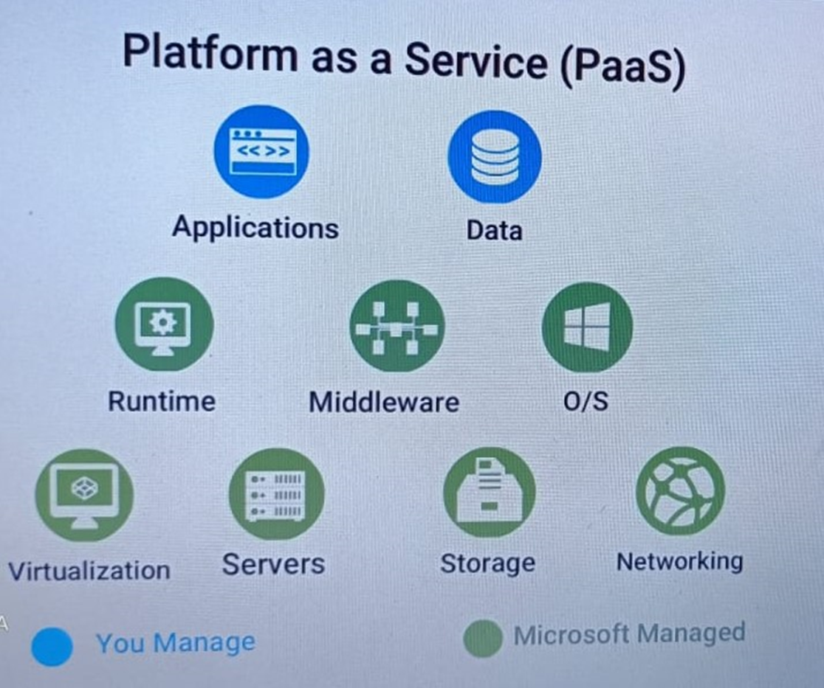

Slide 7
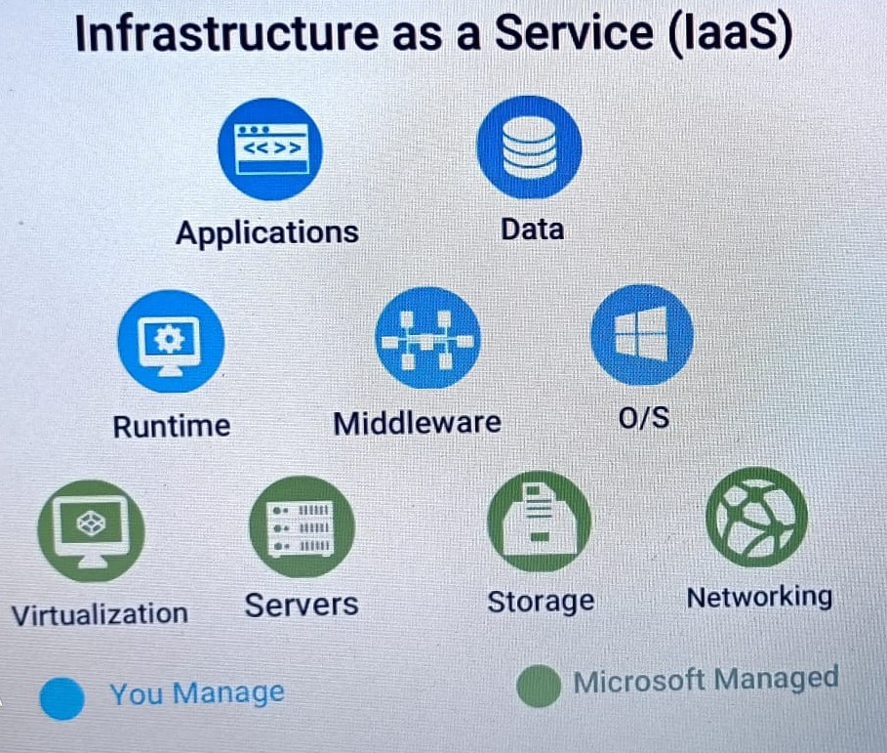

Slide 8
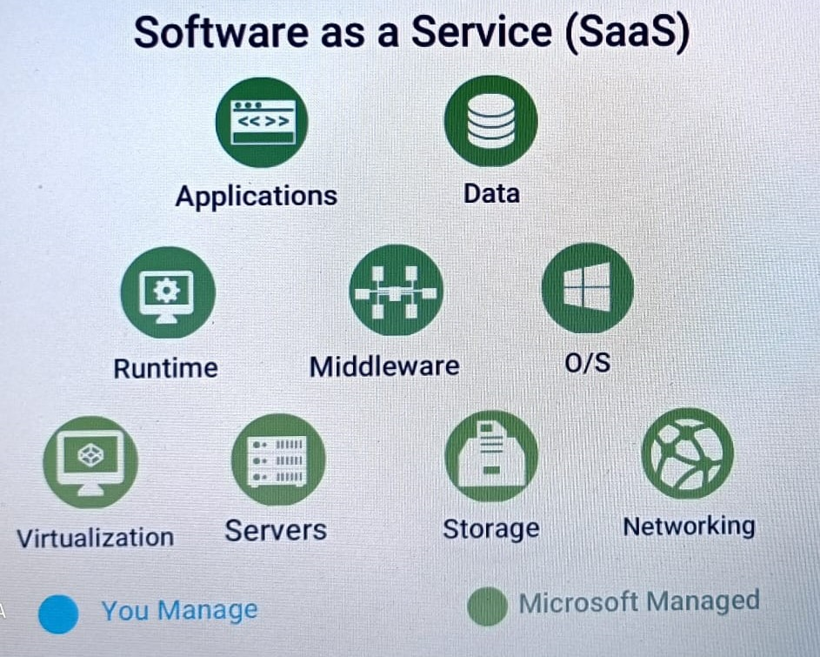

Slide 9
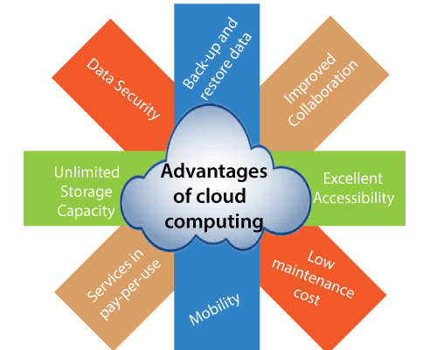
ADVANTAGES OF CLOUD COMPUTING

Slide 10
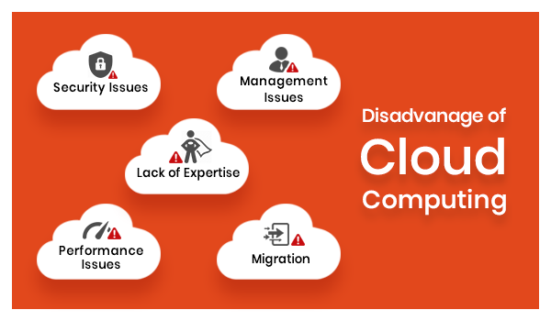
DISADVANTAGES OF CLOUD COMPUTING

Slide 11
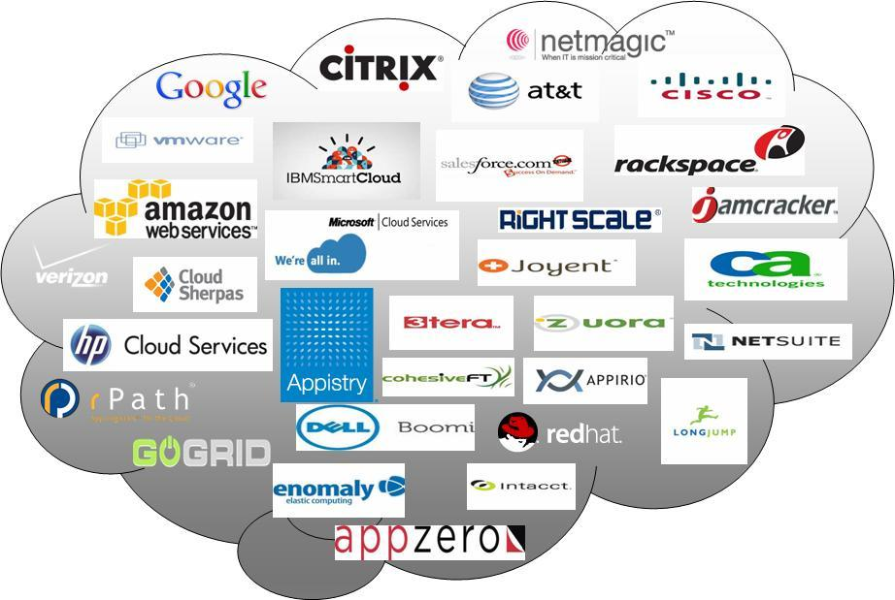
TOP COMPANIES ADOPTED CLOUD COMPUTING

Slide 12
CONCLUSION
In conclusion, cloud computing is recently new technological development that has the potential to own a good impact on the planet. it's several advantages that it provides thereto users and businesses. for instance, a number of the advantages that it provides to businesses, is that it reduces operating expense by disbursement less on maintenance and software system upgrades and focus additional on the companies it self. however there ar different challenges the cloud computing should overcome. individuals ar terribly skeptical regarding whether or not their information is secure and personal. There aren't any standards or rules worldwide provided information through cloud computing. Europe has information protection laws however the North American nation, being one in all the foremost technological advance nation, doesn't have any information protection laws. Users conjointly worry regarding United Nations agency will disclose their information and have possession of their information. But once, there ar standards and regulation worldwide, cloud computing can revolutionize the longer term.

Slide 13
Thank you
For Your Attention!

